Slide 1
Paper Reading

Slide 2
看paper
paper至少看兩次
第一次設定在看懂六成，先求大略知道這篇paper想要做的是什麼，遇到看很久都還看不懂的作個記號、暫時相信他是事實就跳過，很多paper在前半部會先作概述，一些原因或證明都沒交代，看到後面會再做說明。
可由lemma或theorem來整理paper的脈絡。

Slide 3
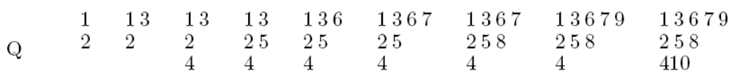
看paper
對每個式子與”trivial”懷疑。
運用觀察力與想像力。
Boundary conditions are important.
寫conclusion

Slide 4
證明
證明依照目的決定看的精細度，只是剛開始找方向時很多的lemma或theorem都先相信他是對的，不需強求看懂，到已經決定要作這個方向時證明就要瞭解七八成，並懷疑看不懂的步驟有可能是有問題的，這就有可能是新的論文題目。

Slide 5
報告paper
要報告的paper最好在一週之前看完兩次。
做完投影片之後要預演，看是否有不流暢的地方。

Slide 6
Edit Distance for a Run-length-encoded String and an Uncompressed String
Information Processing Letters, Vol. 105, pp. 12-16, 2007
Presenter: Chiou-Ting Tseng
Date: Dec. 19, 2007

Slide 7
Abstract
We propose a new algorithm for computing the edit distance of an uncompressed string against a run-length-encoded string. For an uncompressed string of length n and a compressed string with M runs, the algorithm computes their edit distance in time O(Mn). This result directly implies an O(min{mN,Mn}) time algorithm for strings of lengths m and n with M and N runs, respectively. It improves the previous best known time bound O(mN +Mn).

Slide 8
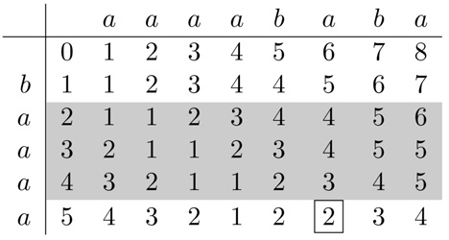
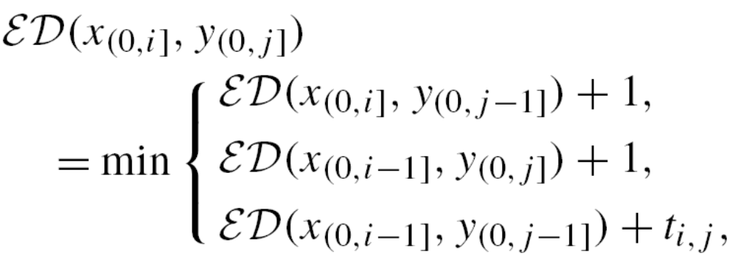
Edit Distance

Slide 9
Run-length-encoded String
X = aaaababa = a⁴b¹a¹b¹a¹
  x₁ = a, x₂ = a, x₅=b
  X₁ = a⁴, X₂ = b¹, X₃ = a¹, X₄ = b¹, X₅ = a¹
Y = baaaa
Define D(i, j)=ED(X_{(0,i ]}, y_{(0,j ]})
  D(2, 3) = ED(aaaab, baa) = 3

Slide 10
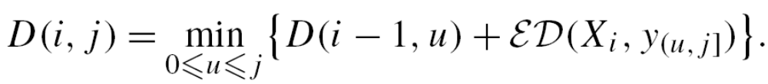
Block Edit Distance
Define D(i, j)=ED(X_{(0,i ]}, y_{(0,j ]})
  D(2, 3) = ED(aaaab, baa) = 3
X
...
i-1
i
...
u
j
Y

Slide 11
Block Edit Distance
O(c)
 |  | a⁴ | b¹ | a¹ | b¹ | a¹
 | 0 | 4 | 5 | 6 | 7 | 8
b | 1 | 4 | 4 | 5 | 6 | 7
a | 2 | 3 | 4 | 4 | 5 | 6
a | 3 | 2 | 3 | 4 | 5 | 5
a | 4 | 1 | 2 | 3 | 4 | 5
a | 5 | 1 | 2 | 2 | 3 | 4

Slide 12
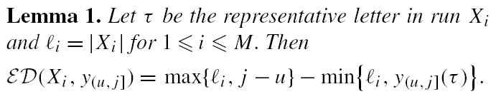
total length
matched length
 |  | a⁴ | b¹ | a¹ | b¹ | a¹
 | 0 | 4 | 5 | 6 | 7 | 8
b | 1 | 4 | 4 | 5 | 6 | 7
a | 2 | 3 | 4 | 4 | 5 | 6
a | 3 | 2 | 3 | 4 | 5 | 5
a | 4 | 1 | 2 | 3 | 4 | 5
a | 5 | 1 | 2 | 2 | 3 | 4
u = 1
j = 4
l_{i} = 4
j – u = 3
y_{(1,4]}(a) = 3
ED = 1
u = 0
j = 4
l_{i} = 4
j – u = 3
y_{(1,4]}(a) = 3
ED = 1

Slide 13
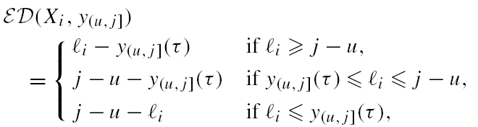
Intra-block Edit Distance

Slide 14
Time Complexity
It is clear that y_{(p,q]}(τ) = y_{(0,q]}(τ) − y_{(0,p]}(τ) can be evaluated in O(1) time for any p ≤ q, provided the pre-computation of y_{(0,t ]}(τ ) for 0 ≤ t ≤ n.
The pre-computation can be finished in total O(n) time for each letterτ by a linear scan of Y.

Slide 15
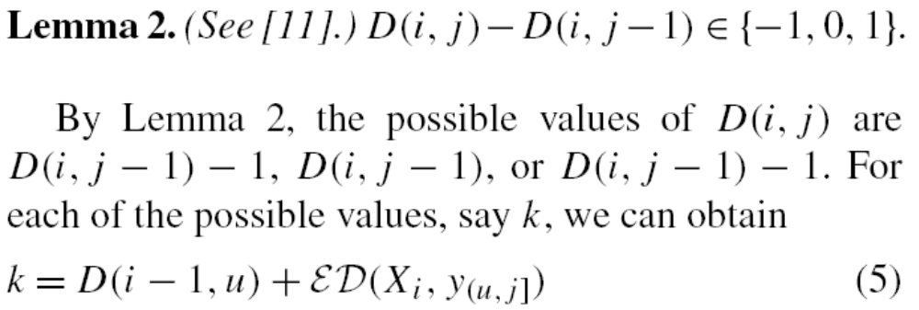

Slide 16
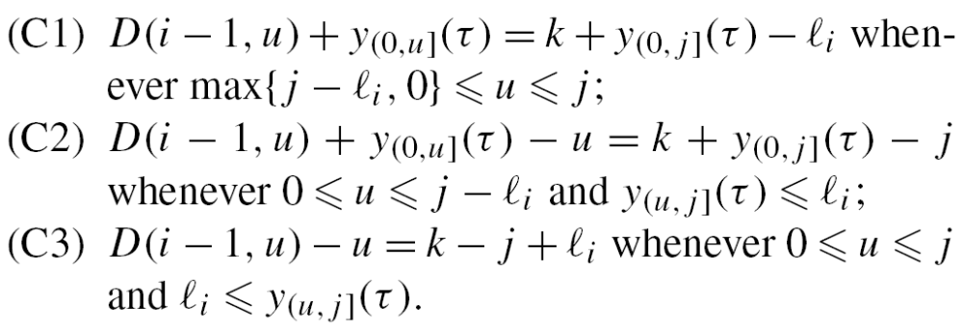
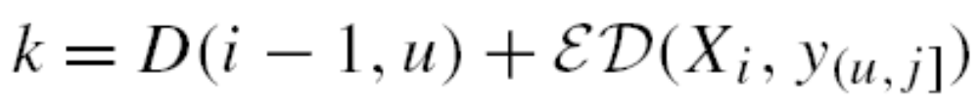
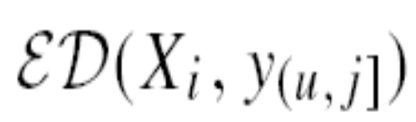


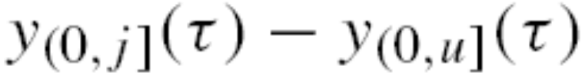
將有u的放到左邊，其他到右邊

Slide 17
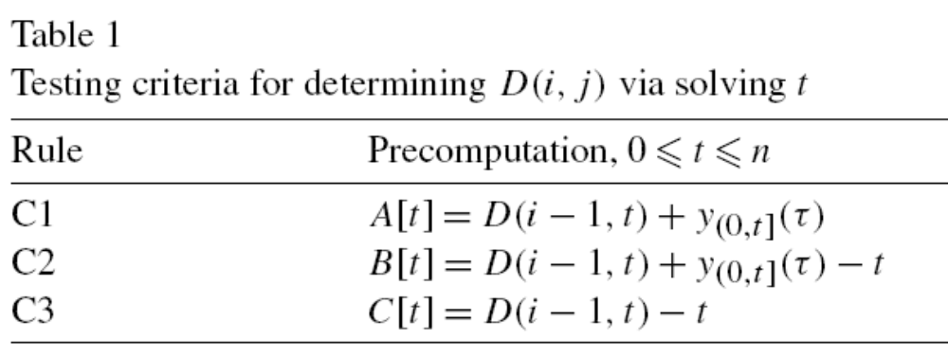
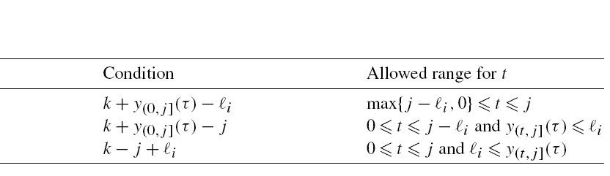
Testing Criteria
Name the

Slide 18
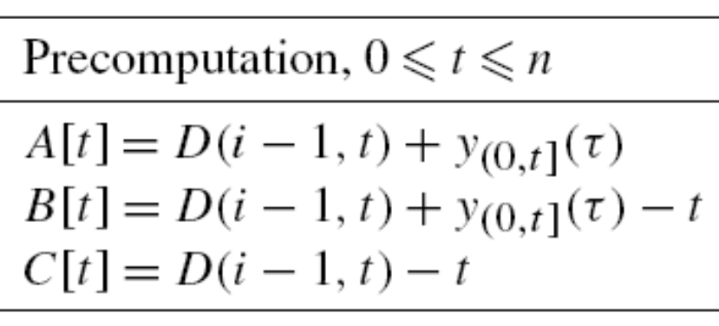
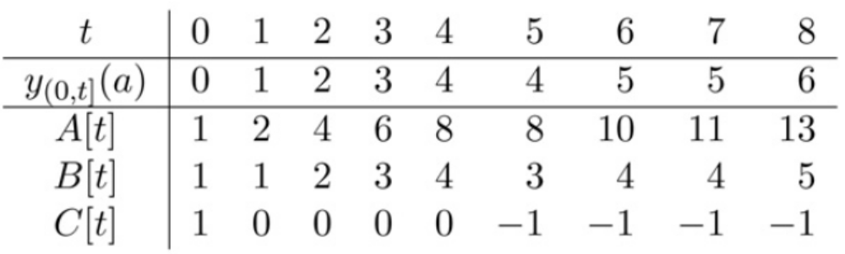
Precomputation

Slide 19
k = 1
1 + 5 - 4 = 2
t = 1
max{6-4, 0} ≤ 1 ≤ 6
k = 2
2 + 5 - 6 = 1
t = 0 or 1
0 ≤ 0 ≤ 6-4 and 5-0 ≤ 4
0 ≤ 1 ≤ 6-4 and 5-1 ≤ 4

Slide 20
Inverse Lookup
In the above process, scanning an array will take O(n) time on each trail. To find an efficient way, our approach is to build inverted lists A⁻, B⁻ and C⁻ for arrays A, B and C, respectively, such that A⁻[v₁] = t , B⁻[v₂] = t, or C⁻[v₃] = t if and only if there is an index t such that A[t] = v₁, B[t] = v₂, or C[t] = v₃. A⁻[v₁], B⁻[v₂],and C⁻[v₃] are defined as follows.

Slide 21
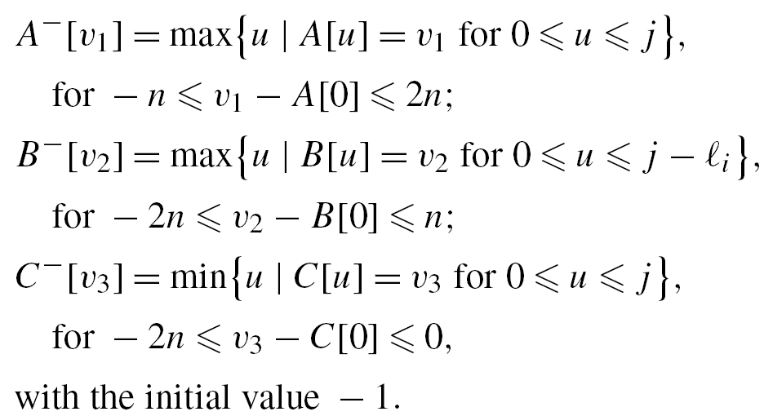
Inverse Lookup

Slide 22
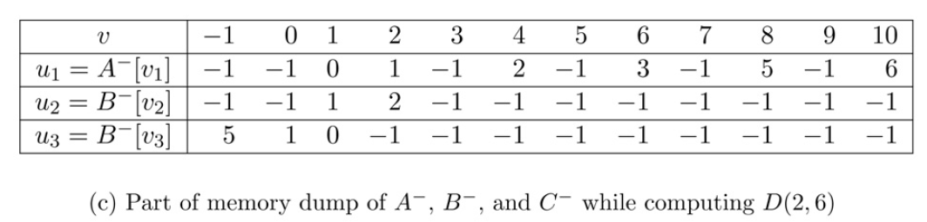
Inverse Lookup

Slide 23
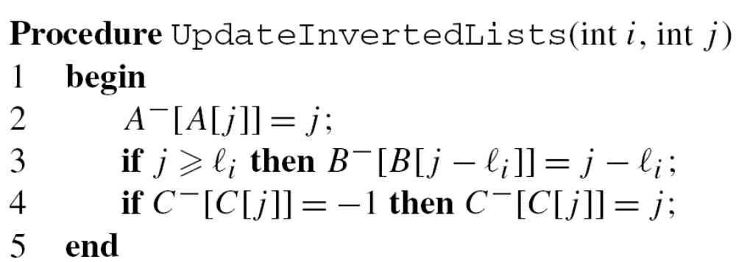
Update Inverted Lists
Note that A⁻, B⁻, and C⁻ depend on j (index for y_{j} ) and i (index for X_{i} ). We omit the dependency because they can be updated incrementally in O(1) time

Slide 24
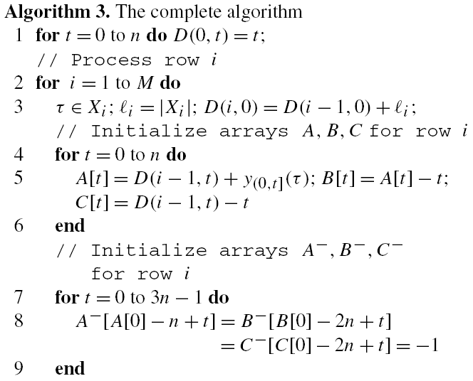

Slide 25
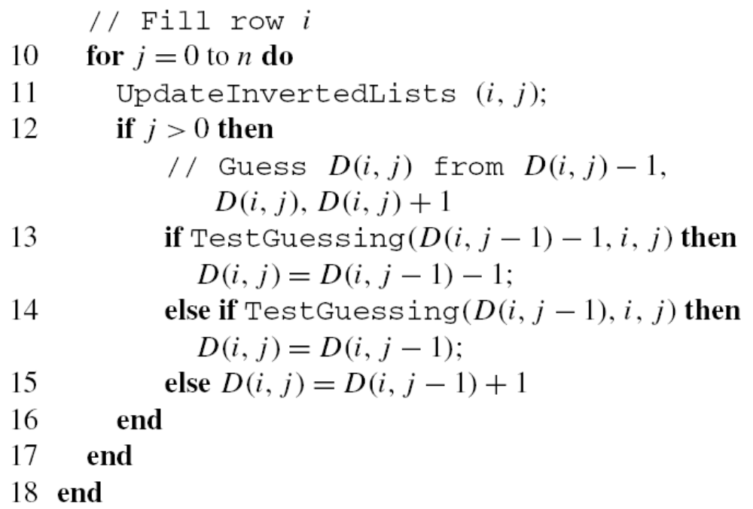

Slide 26
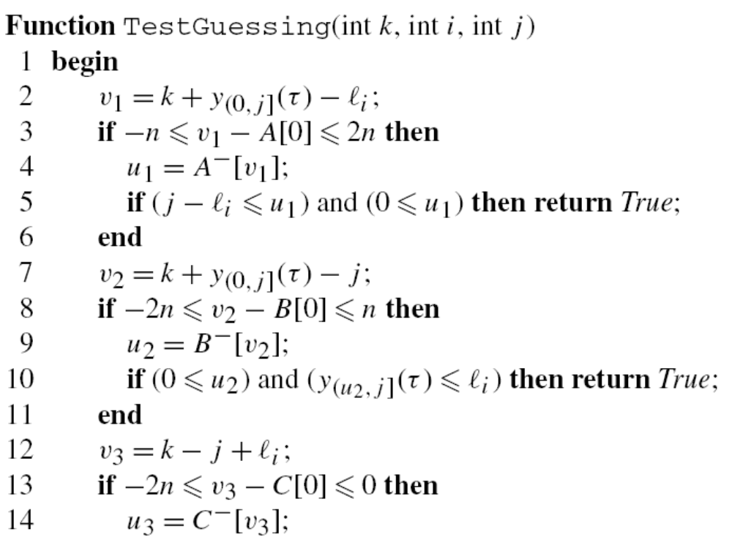
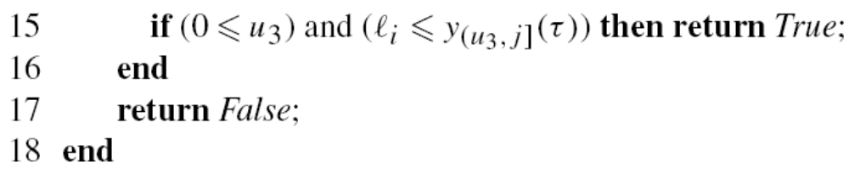

Slide 27
Conclusion
For any two strings X and Y, we can choose to compress X or compress Y. Therefore, we conclude that their edit distance can be computed in O(min{mN,Mn}) time.

